Slide 1


SECURE FILE SHARING SYSTEM

Slide 2

ShareWithMe☺

Slide 3

PROJECT DETAILS:
Project number – 06
Mentor Details:
Employee number-
Employee name –
TEAM DETAILS :
2200032007- Y . Sai Bhargav
2200033014- manoj Sriram Chandra Varma Patta
2200031349-k. Ajay babu

Slide 4


Reimagining Data Sharing: Prioritizing Privacy Above All Else
In today's interconnected world, the exchange of digital files is a part of our daily routine. But traditional data sharing methods may compromise our personal contact details. Let's explore a new approach to data sharing that prioritizes privacy.

Slide 5

A New Approach to Data Sharing
Privacy by Design
Anonymous Sharing
Easy and Fast
Privacy-first sharing platforms prioritize ease-of-use, enabling quick and intuitive file sharing for all.
A new approach to data sharing prioritizes privacy by using sophisticated encryption methods and never exposing personal data.
Anonymous sharing methods guarantee the confidentiality of personal data by separating the link between data and person.

Slide 6

The Concept of Privacy-First Sharing
1
End-to-End Encryption
Data is encrypted and decrypted only by the recipient for maximum privacy.
2
Anonymous Sharing
Privacy-first sharing platforms guarantee the anonymity of the sender and receiver of data.
3
Easy Sharing
Privacy-first sharing platforms provide easy and fast file sharing without sacrificing security.

Slide 7
Features of a Privacy-First Sharing Platform
Secure Account Creation
Encrypted Data Storage
Authenticate your identity to create a secure account with multifactor authentication.
Data remains encrypted for increased security and is only decrypted on the recipient's device.
Intuitive User Interface
Multiple File Formats
Support for a variety of file formats, including video, audio, and documents, for seamless sharing.
Easy to navigate, user-friendly interface for quick and simple data sharing.

Slide 8


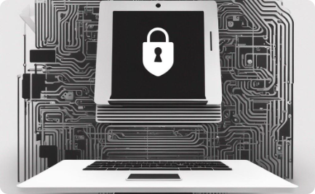
Examples of Successful Privacy-First Sharing Solutions
ProtonMail
Signal
Keybase
An encrypted email service that does not log IP addresses.
An end-to-end encrypted messaging service with open-source code.
A secure messaging and file sharing solution that uses public key cryptography.

Slide 9

The Future of Data Sharing and the Role of Privacy
1
The Future of Data Sharing
2
The Role of Privacy
Privacy must be at the forefront of technological innovation.
Privacy-first sharing will become the norm for individuals and businesses.
Individuals and organizations will demand more control over their data.
A greater focus will be placed on privacy and data security in the design of new platforms.
Privacy is a fundamental human right and should be protected by law.
More organizations will adopt privacy-first sharing as part of their approach to data sharing.

Slide 10
Thank You ☺

